Slide 1
Hardware Required:
Raspberry PI 2 & SD Card with Raspbian Operating System
USB Power Supply
USB Cable
Breadboard & Jumper Wires
2 x DHT 11 sensors

Slide 2
Step 1:
Make your Connections Over Bread Board.
For this circuit we need to use the 3.3v out from the Raspberry Pi Pin 1 (do not use the 5v on Pin 2) and we need Ground (GND) of course. Connect these from the Pi to the Breadboard.
The DHT 11 has 4 Pins. Pin 1 is VCC, Pins 2 is Data, Pin 3 is NOT USED, Pin 4 is Ground.
Connect DHT 11 Pin 1 to 3.3v
Connect DHT 11 Pin 2 to Raspberry PI Pin 16/GPIO 23 and connect a 4.7 or 10k resistor from DHT 11 Pin 2 to DHT Pin 1
Connect DHT 11 Pin 4 to Ground

Slide 3
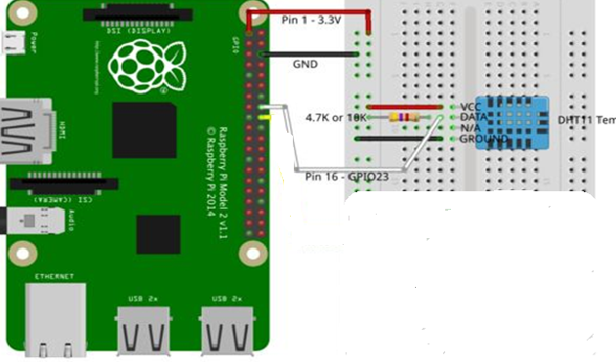

Slide 4
Step 2:
Insert Your SD Card With Burned Image File Of Raspbian Jessie and Give Proper Power Supply to it.
Warning - you can destroy your Raspberry Pi with a short circuit from a wrong connection. Just be careful and double check everything before powering back on.

Slide 5
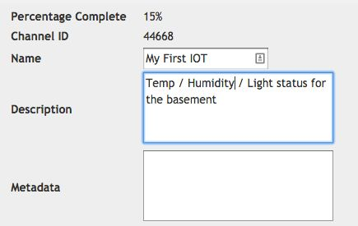
Step 3:
Python Script will read Data from DHT11 and publish the value over Thingspeak.
ThingSpeak Setup:
Create Free Account
Click on My Channels
Click on New Channel
Name the Field (Ex. Temperature, Humidity) according to the order used in python script
Note: You can decide you want to keep your channel public or private
You will also need the Write API key for the channel as it will be required to post data to the channel.

Slide 6
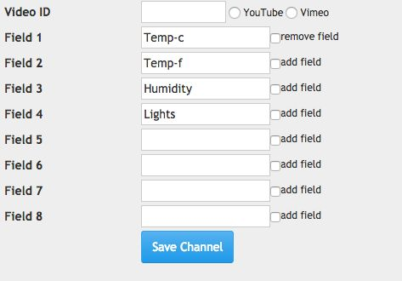
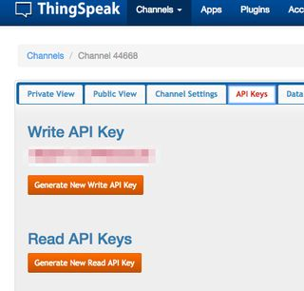
Setup Thingspeak for our IOT data

Slide 7
Step 4:
Launch IDLE on the Raspberry Pi
To Launch IDLE on the Raspberry Pi go to MENU -> Programming -> Python 3
To start writing our script go to FILE -> NEW and a new, untitled window will appear. This is where we will actually write our code. Save and name the file before we begin. Go to FILE ->Save and the file myfirstIOT.py
Take note of the directory you saved it in. It is probably /home/pi
Don't forget to add the ".py" at the end of your file, IDLE will not add it automatically.

Slide 8
Step 6:
Create the Python Script
import sys
import RPi.GPIO as GPIO
import os
from time import sleep
import Adafruit_DHT
import urllib2
def readDHT():
humidity,temperature

Slide 9
Step 6:
#Setup our API and delay
myAPI = "YNGRTI42PM9SOGZE"
myDelay = 15 #how many seconds between posting data
GPIO.setmode(GPIO.BCM)
GPIO.setup(RCpin, GPIO.IN, pull_up_down=GPIO.PUD_DOWN)
def getSensorData():
RHW, TW = Adafruit_DHT.read_retry(Adafruit_DHT.DHT11, DHTpin)

Slide 10
Step 6:
#Convert from Celius to Farenheit
TWF = 9/5*TW+32
# return dict
return (str(RHW), str(TW),str(TWF))
def RCtime(RCpin):
LT = 0
if (GPIO.input(RCpin) == True):
LT += 1
return (str(LT))

Slide 11
Step 6:
# main() function
def main():
print 'starting...'
baseURL = 'https://api.thingspeak.com/update?api_key=%s' % myAPI
print baseURL
while True:
try:
RHW, TW, TWF = getSensorData()
LT = RCtime(RCpin)

Slide 12
Step 6:
f = urllib2.urlopen(baseURL +
"&field1=%s&field2=%s&field3=%s" % (TW, TWF, RHW)+
"&field4=%s" % (LT))
print f.read()
print TW + " " + TWF+ " " + RHW + " " + LT
f.close()
sleep(int(myDelay))
except:
print 'exiting.'
break

Slide 13
Step 7:
Start Your IOT Engine!
Open LXTerminal. At the default command prompt you should be in the /pi directory already.
sudo python myfirstIOT.py
Each line printed locally will display:
Temp (c) - Temp (f) - Humidity
Then go check you Channel on Thingspeak, you should have data.

